Slide 1

Commune Action Plan
This user guide will help you walkthrough the Commune Action Plan.

Slide 2
How to access the console?
Access the mWater portal.
Access the HANWASH portal.

Slide 3
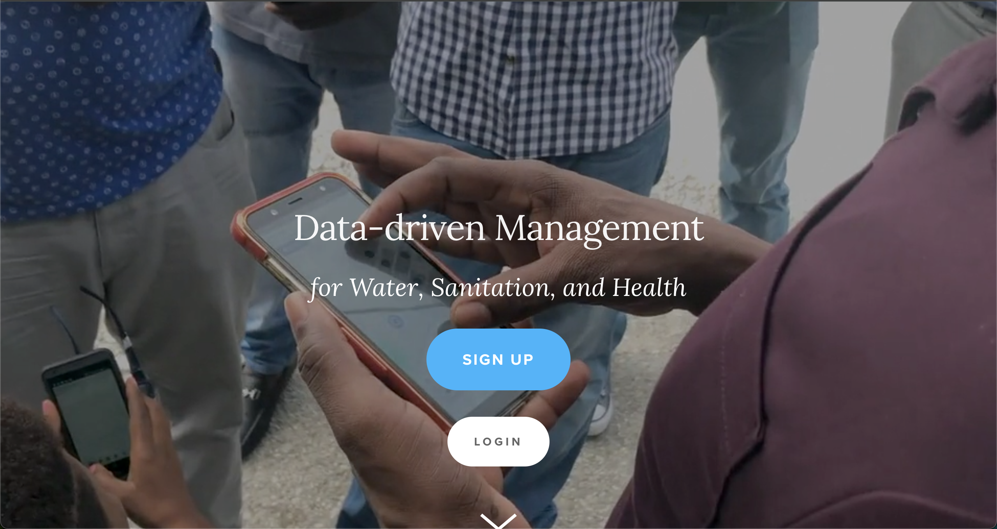
Mwater Home
URL LINK : https://www.mwater.co

Slide 4
Authenication PRocess
Click on the Login button.

Slide 5
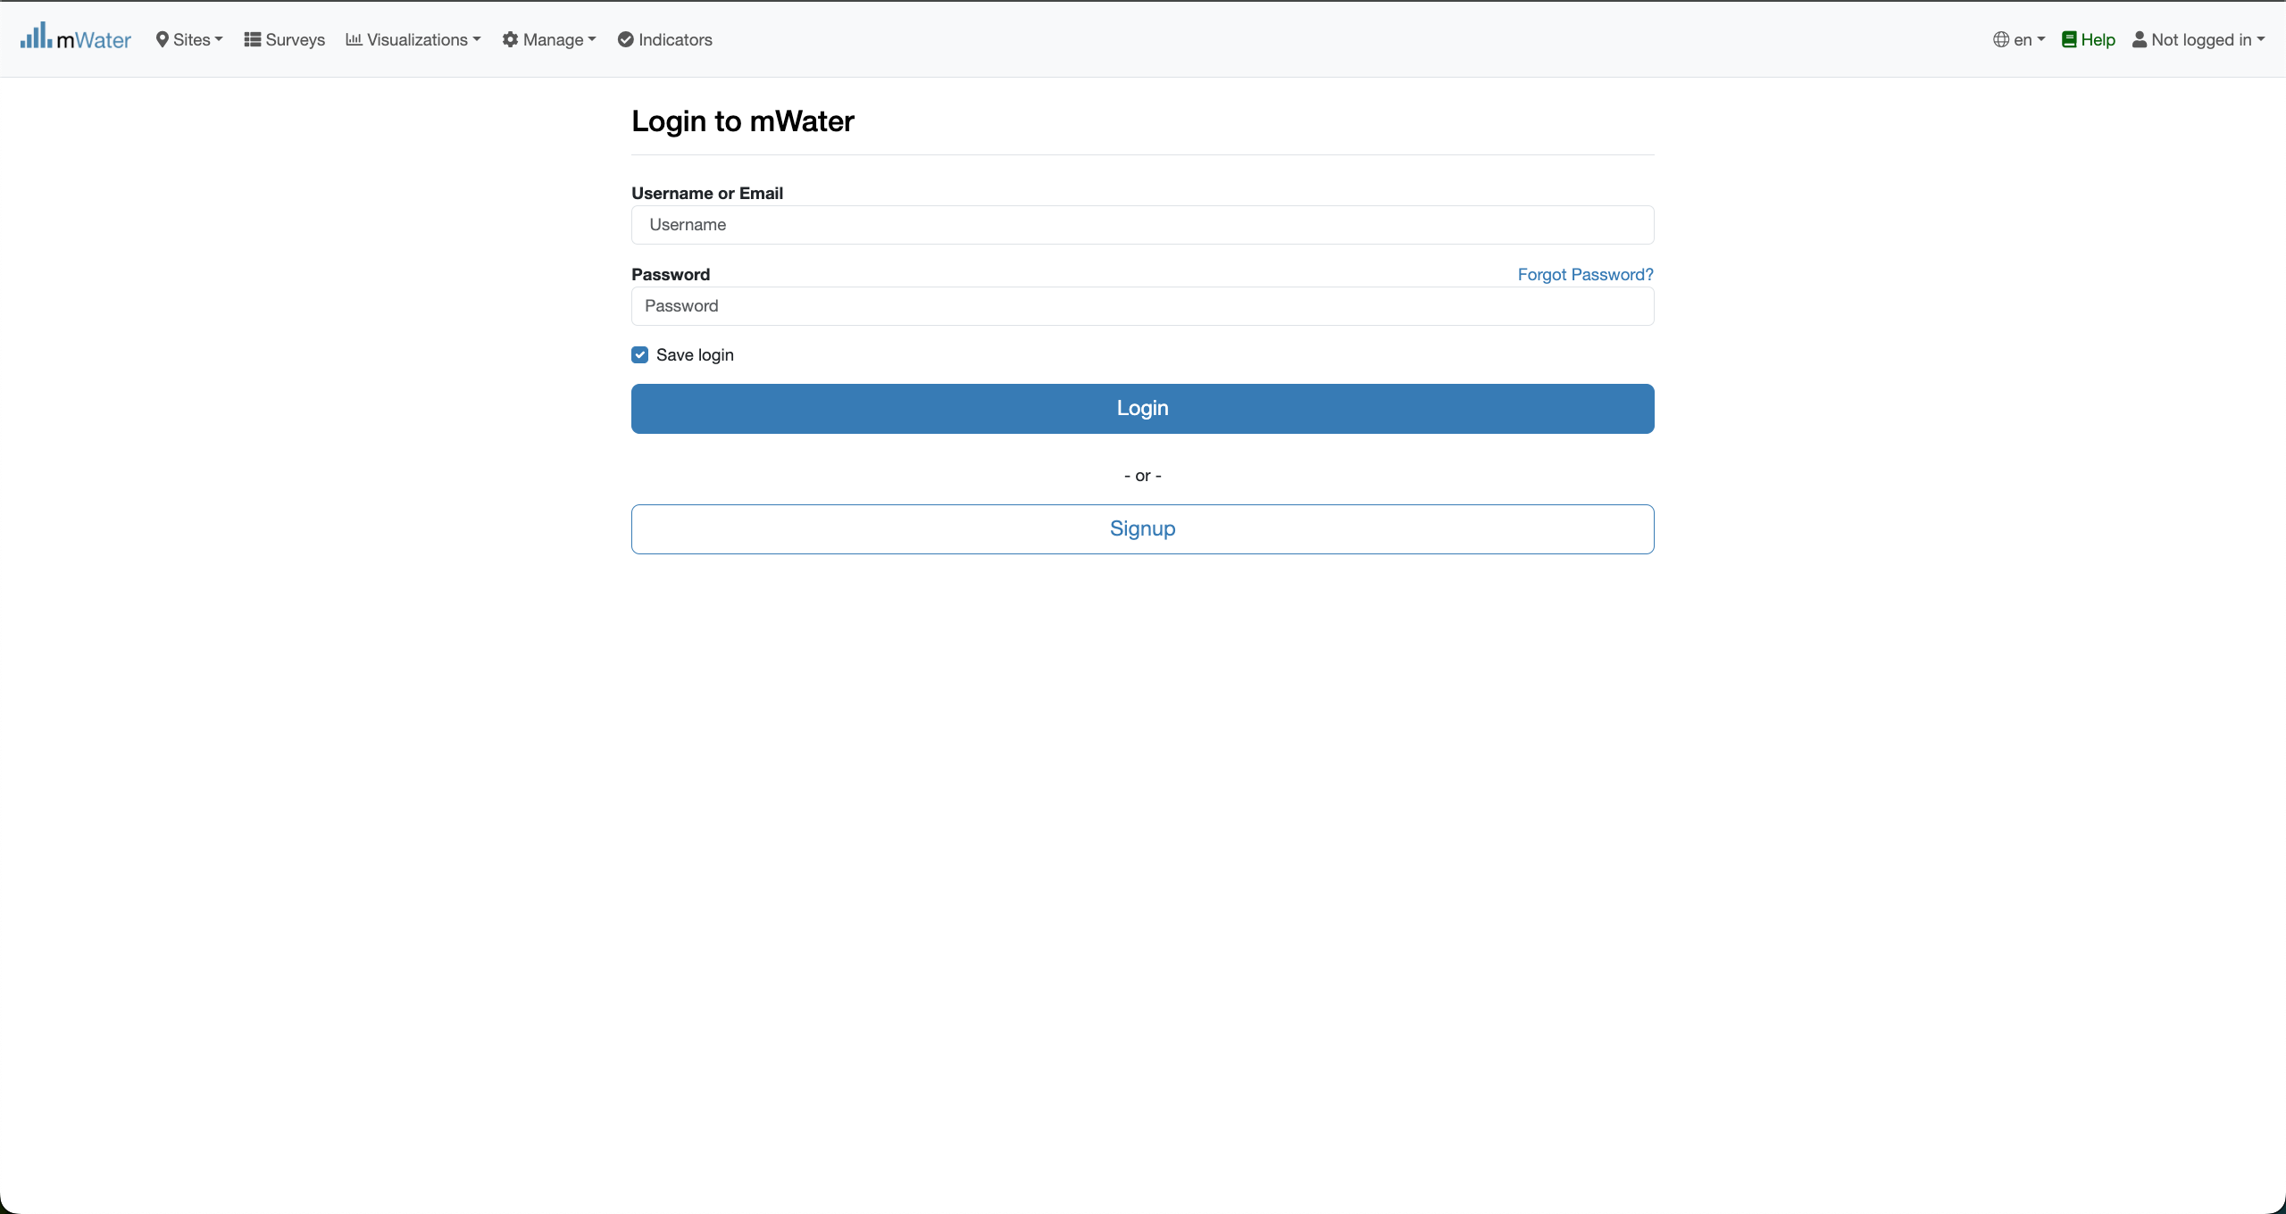
Authentication PRocess
You are not logged in.
Fill with your credentials and click on the log button.

Slide 6
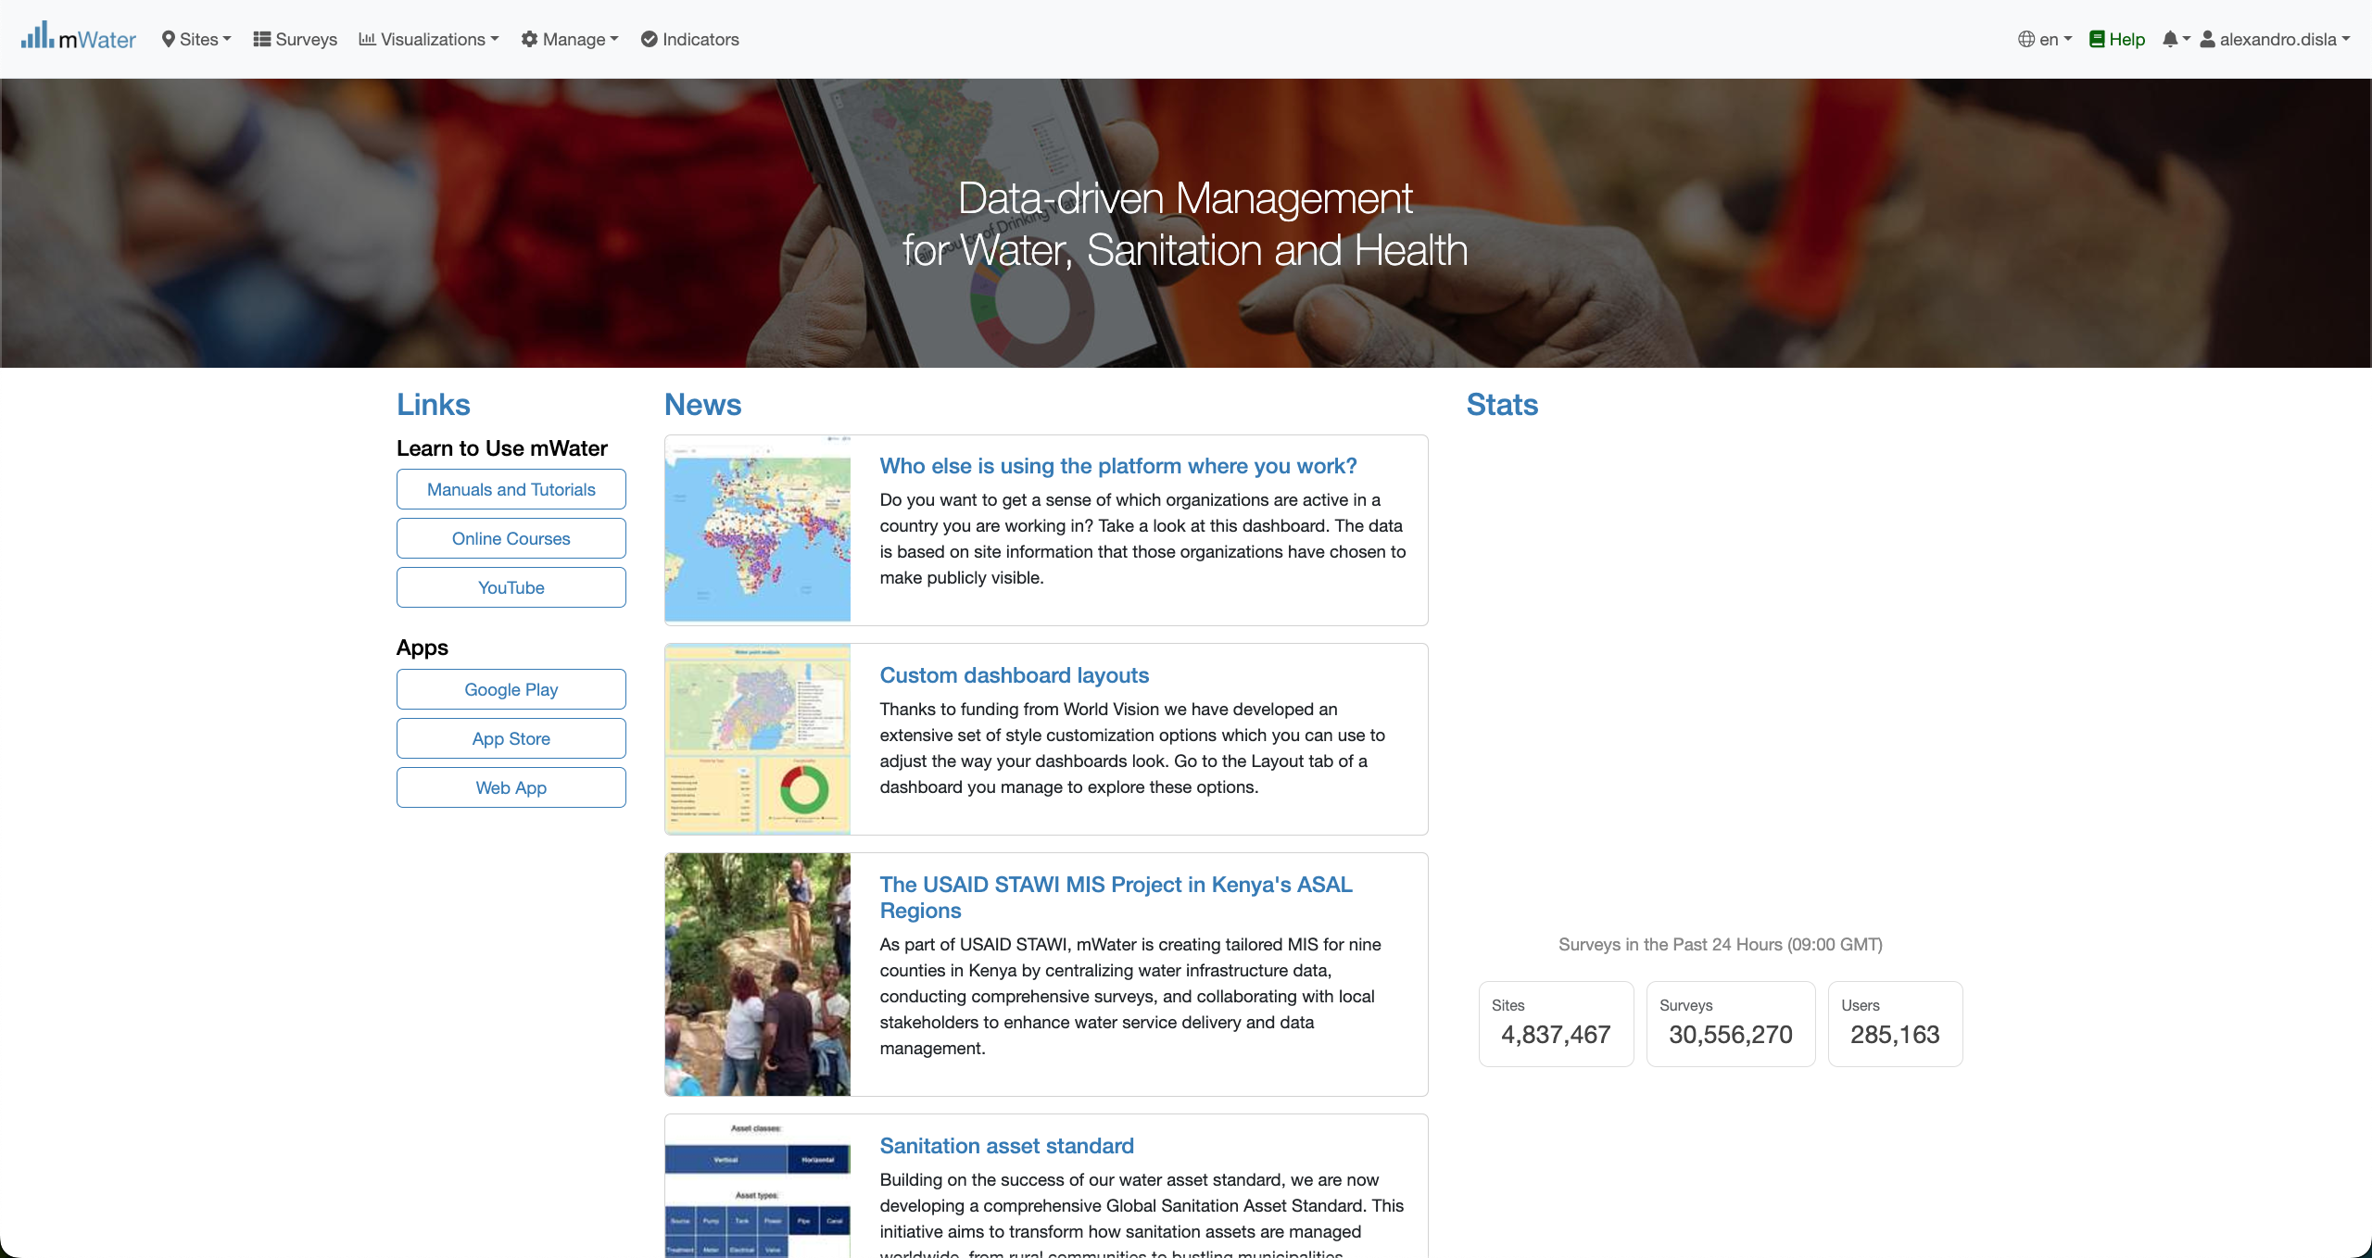
Mwater Home page Portal
You have successfully logged in.

Slide 7
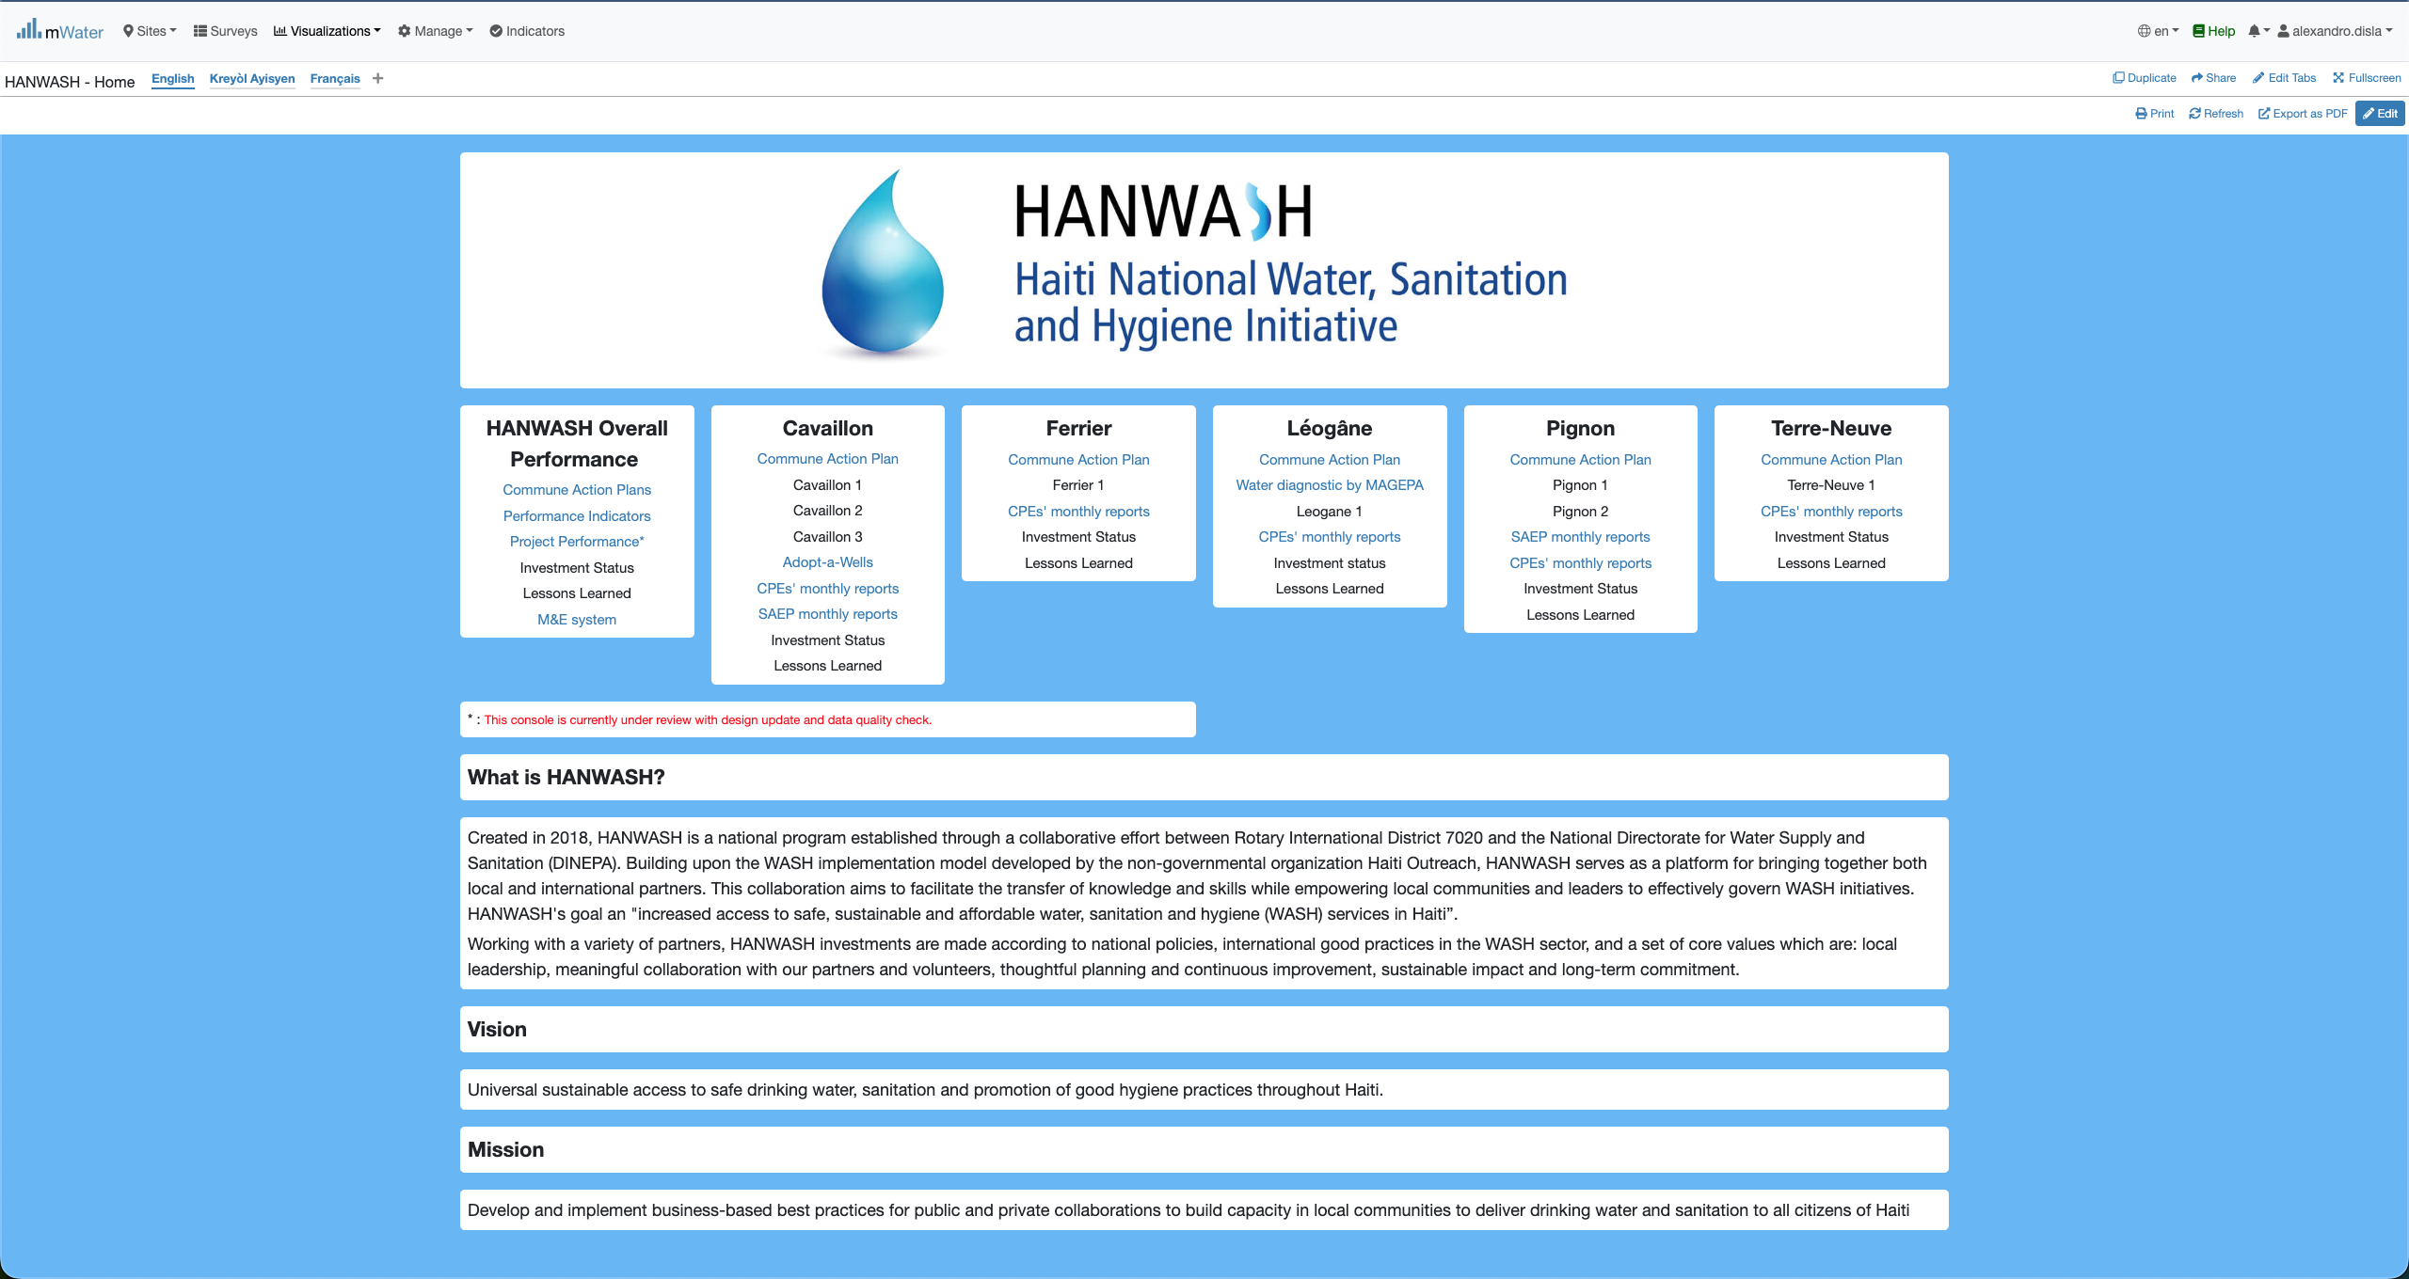
Hanwash HOME
After you have been logged in mWater. Please use this link in your browser to access the HANWASH HOME CONSOLE, quickly.
URL LINK : http://go.mwater.co/hanwash

Slide 8
Access the CAP CONSOLES
We make sure to make the Commune Action Plan available for each commune. It’s also available in the Overall Performance Box. Select the One that match your interest.

Slide 9
Console Overview
We have three page in the console. We are focusing this presentation intentionally in the CAP page. We have these sections in the page:
CAP MAP
# of interventions by Wash Focus, Intervention & Infrastructure Types (Planned)
# of Interventions by implementation status
% of population with basic access to WASH services (Baseline vs Projected vs Current)

Slide 10
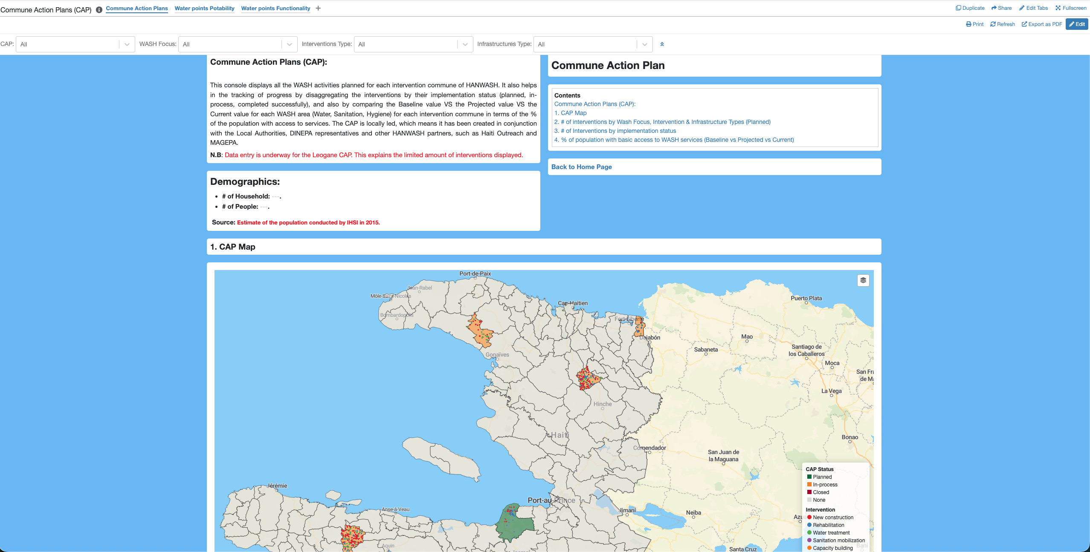
CAP Console overview

Slide 11
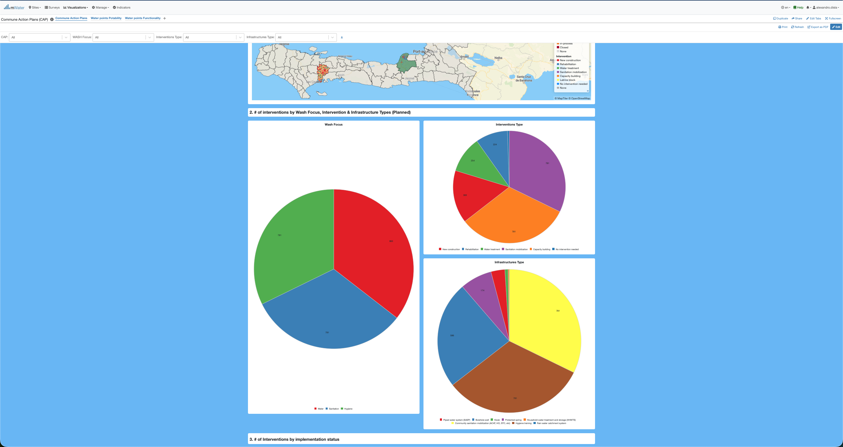
CAP Console overview

Slide 12
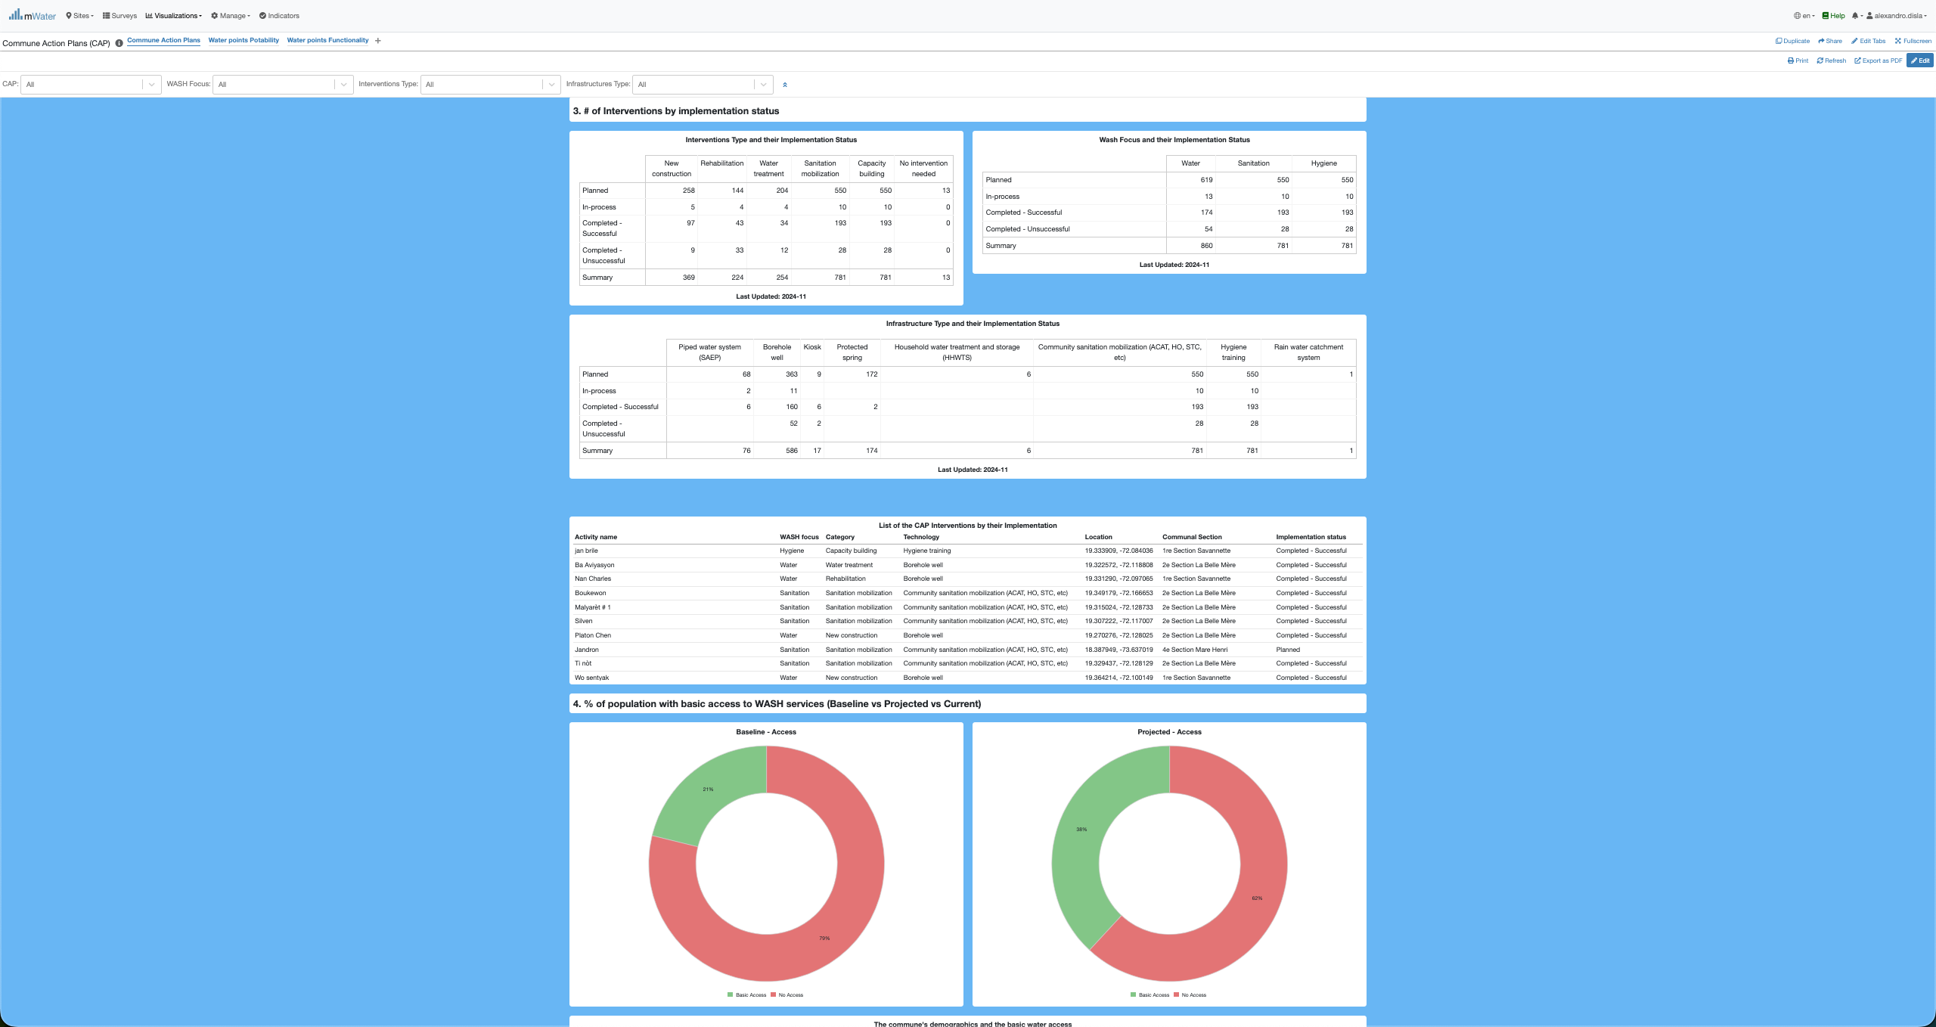
CAP Console overview

Slide 13
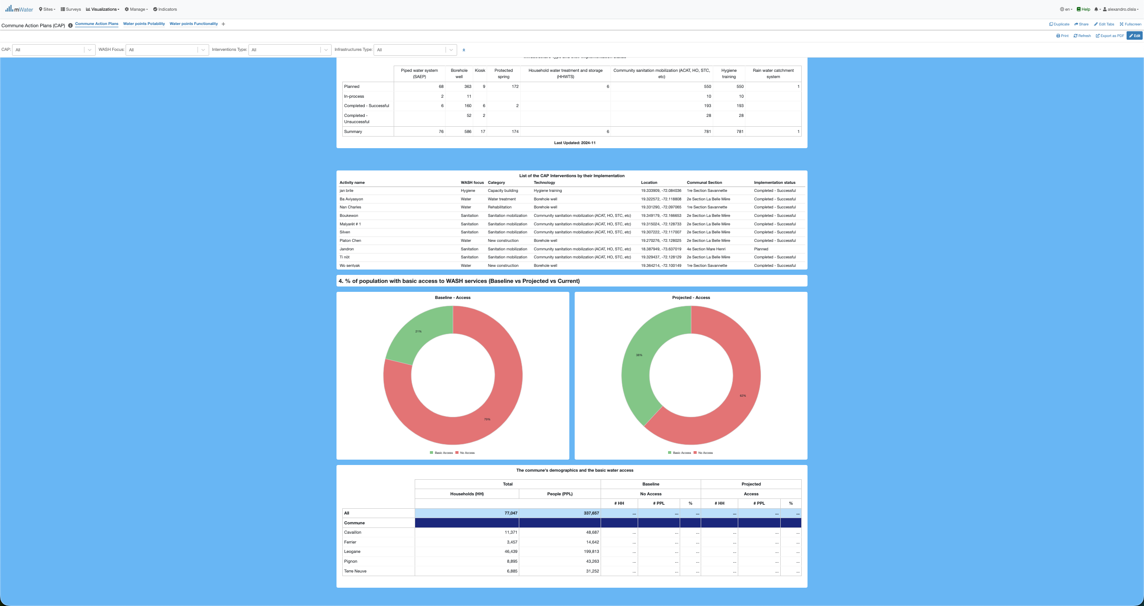
CAP Console overview

Slide 14
Functionalities
Functionalities available in the console

Slide 15
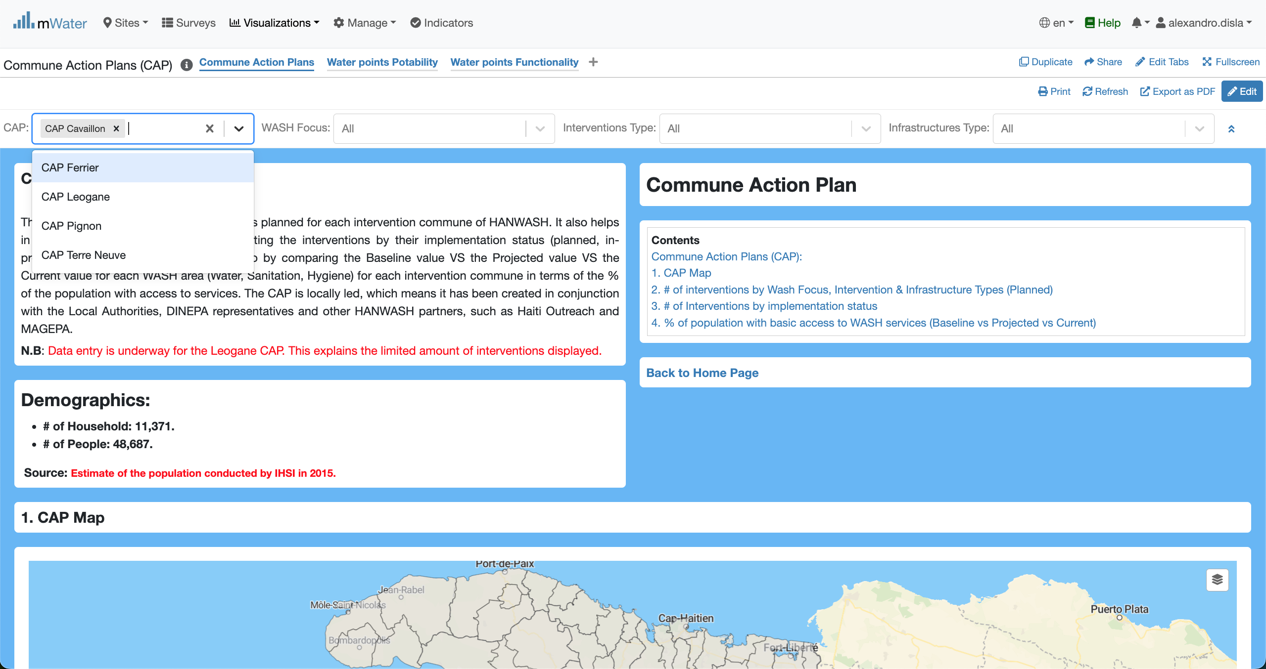
Quick filters
The filters will act on the components of the dashboard by design.

Slide 16
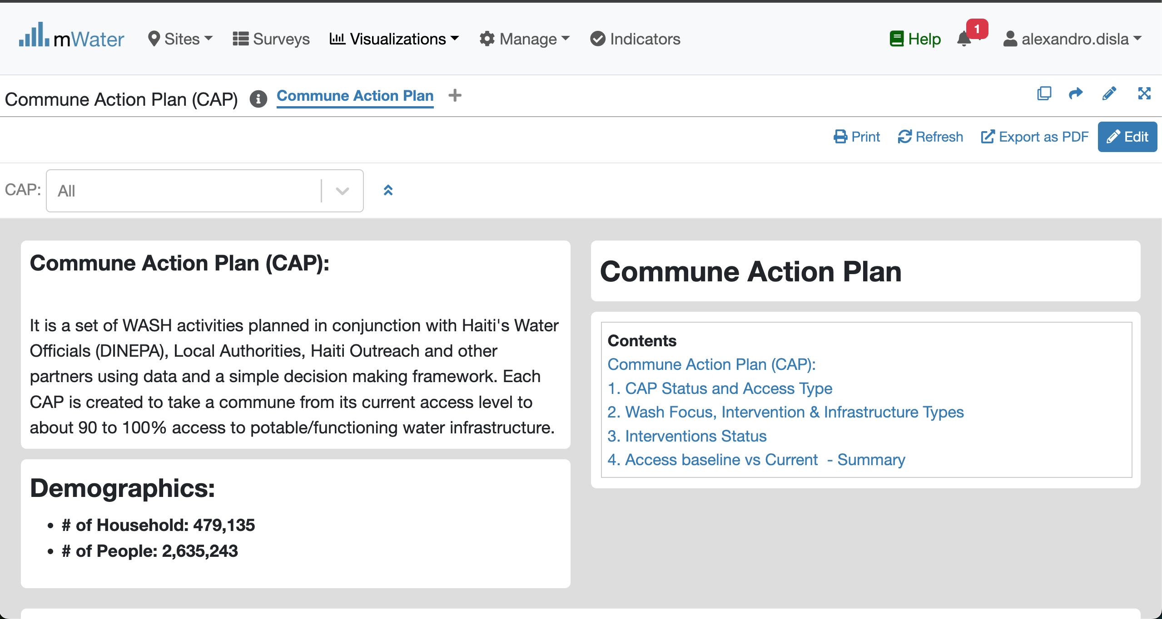
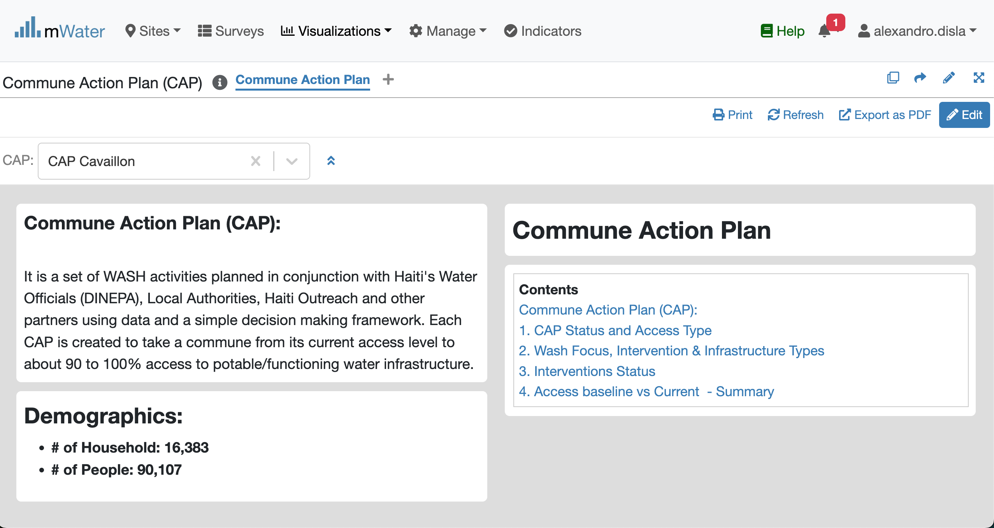
Effect of the Quick Filters

Slide 17
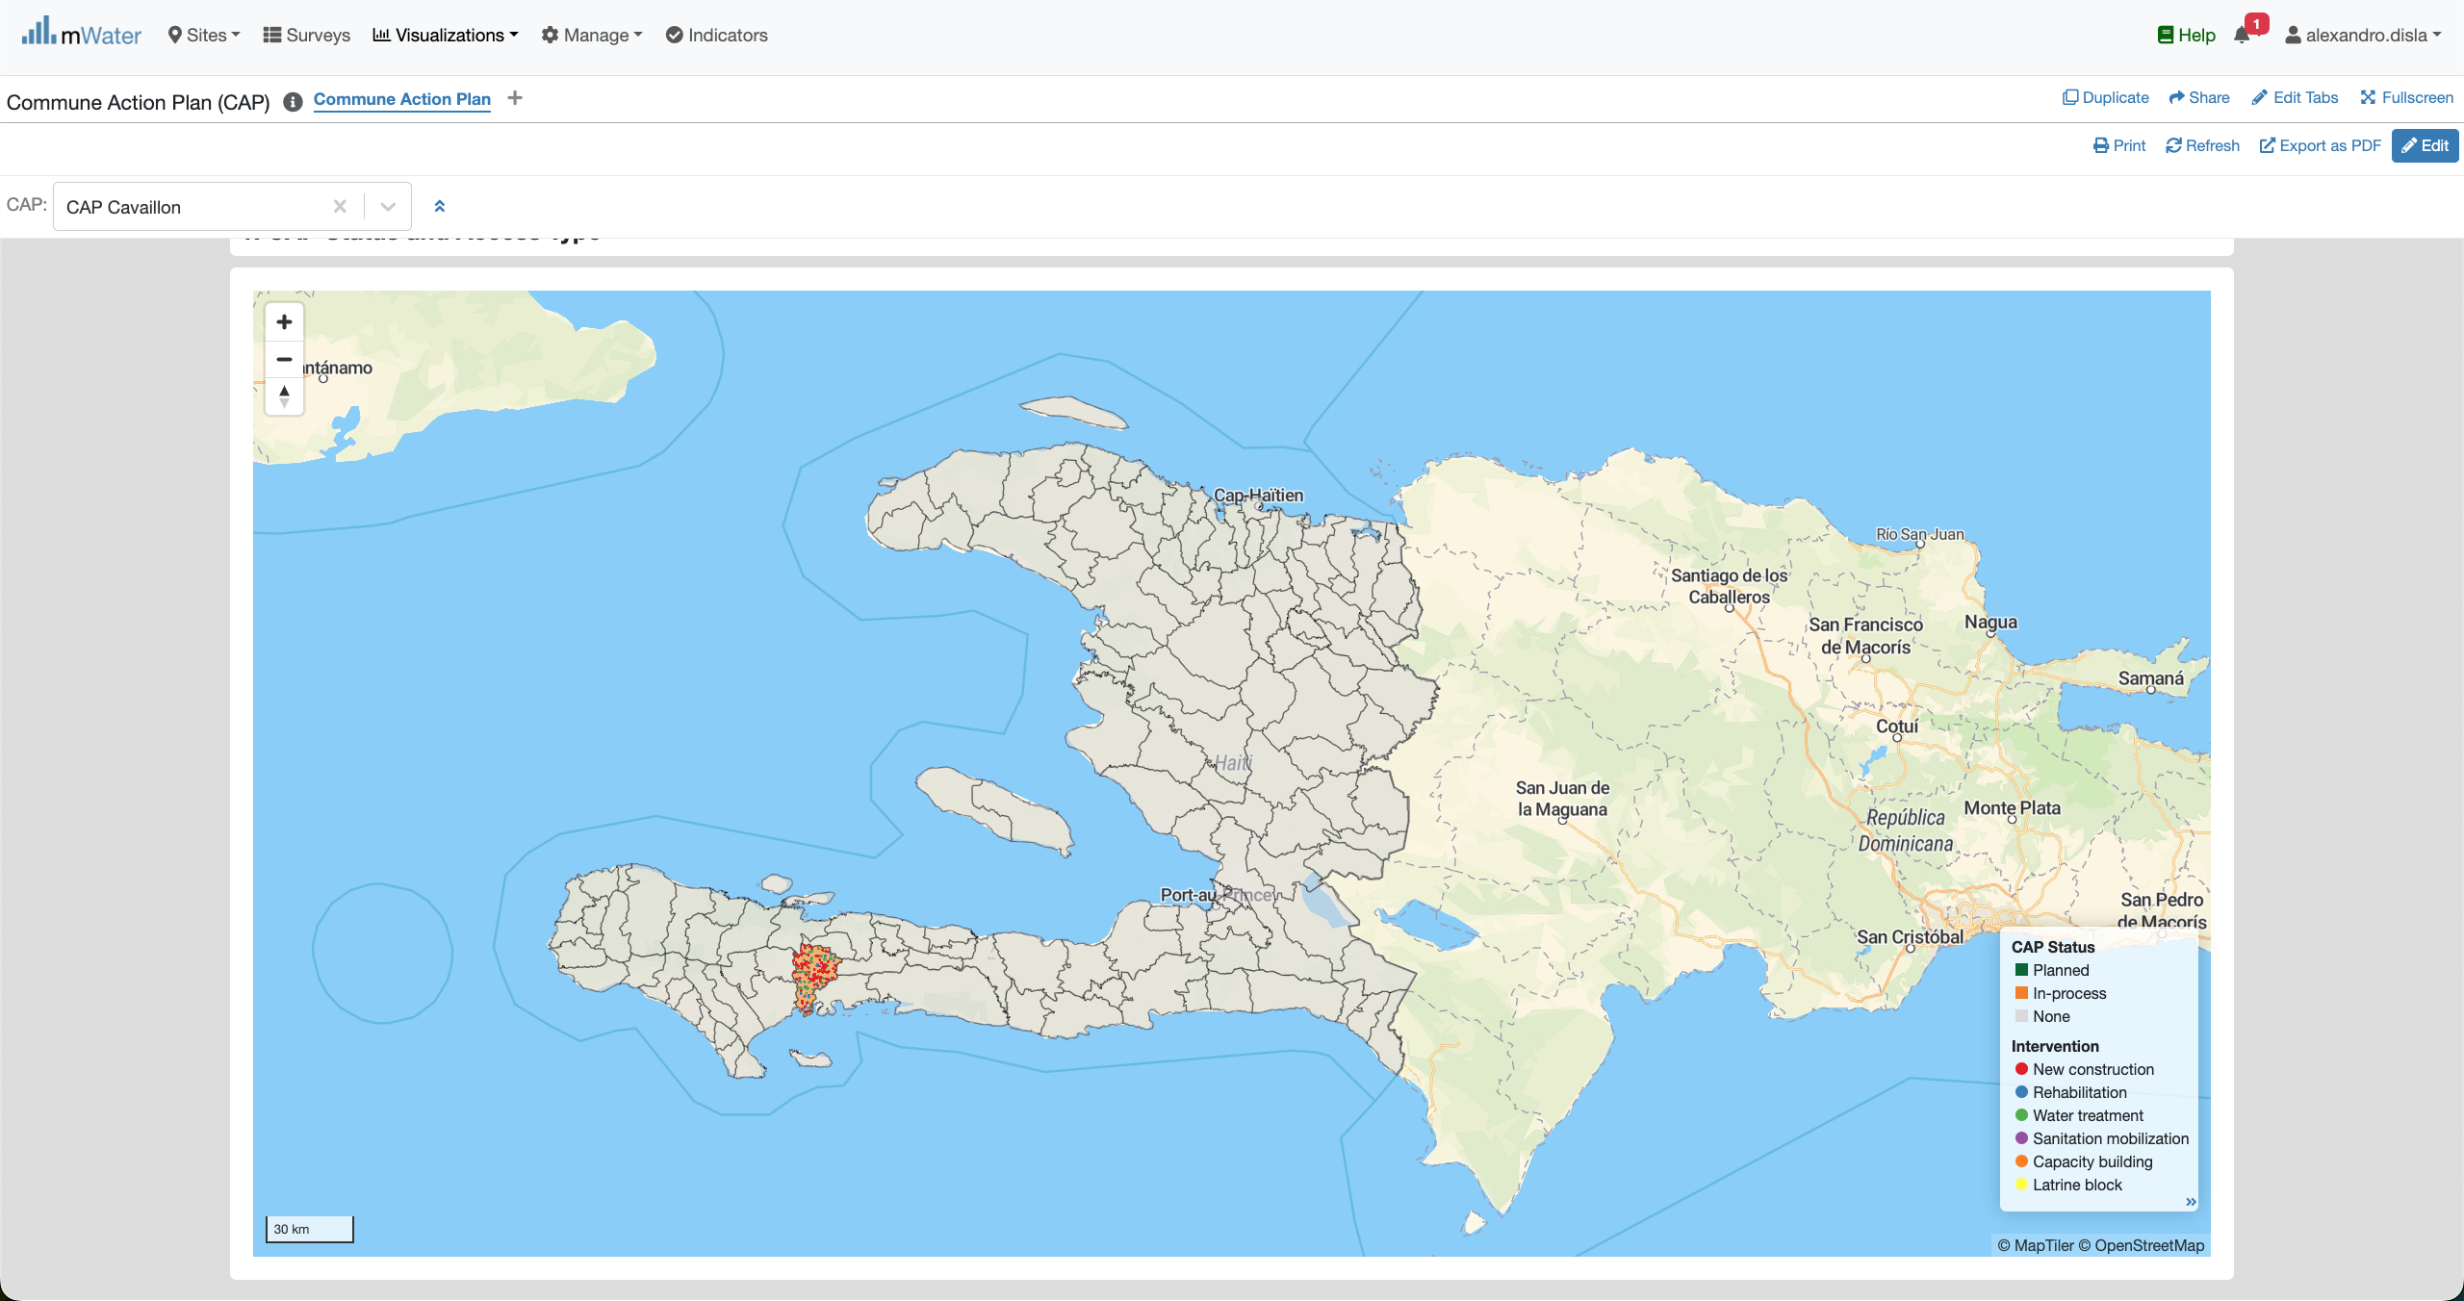
The Map

Slide 18
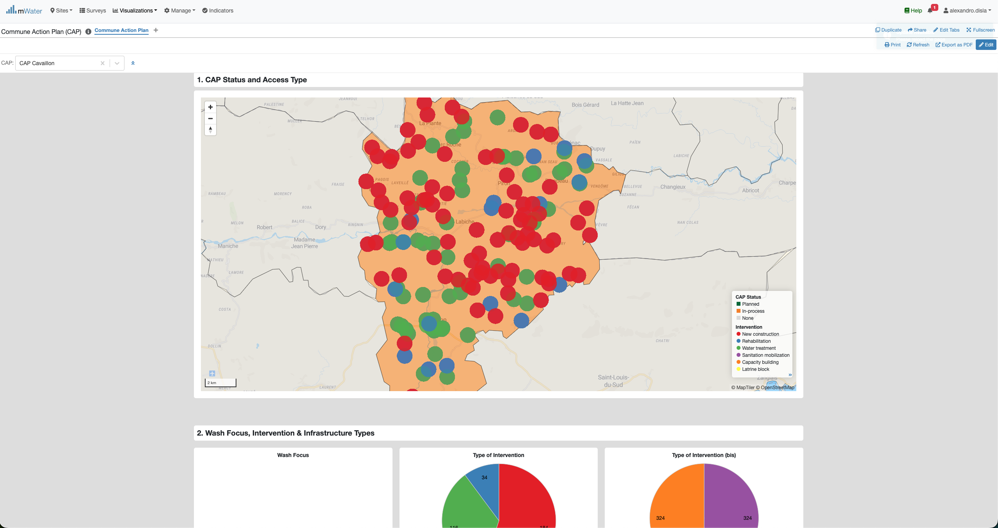

The map- Zoom
Zoom Control
Help you go over the map.

Slide 19
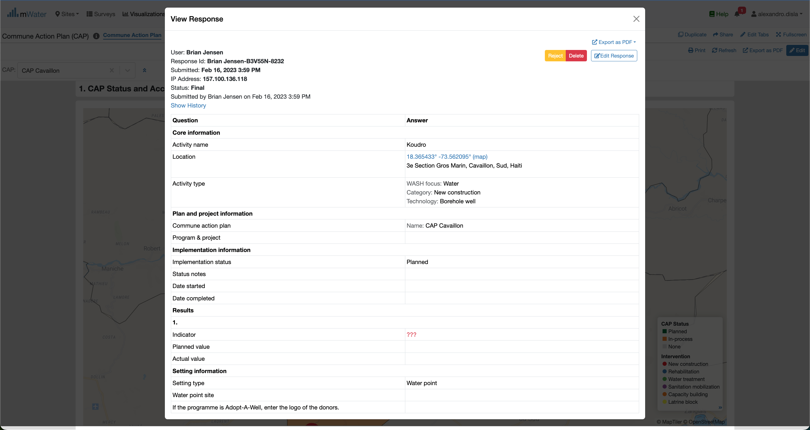
MAP – selection of a Point

Slide 20
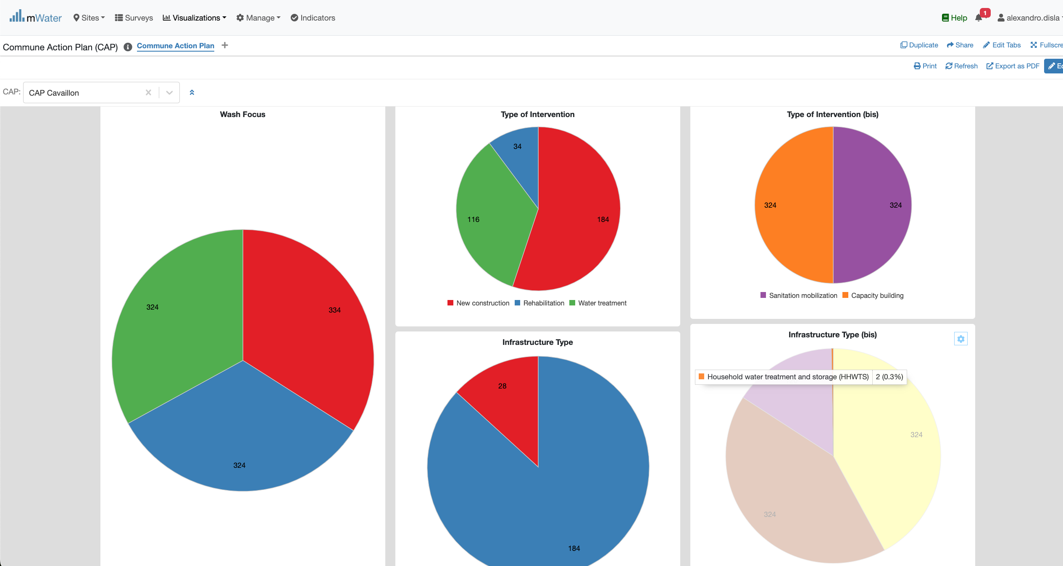
Pie Charts
Instant Hover Effect

Slide 21
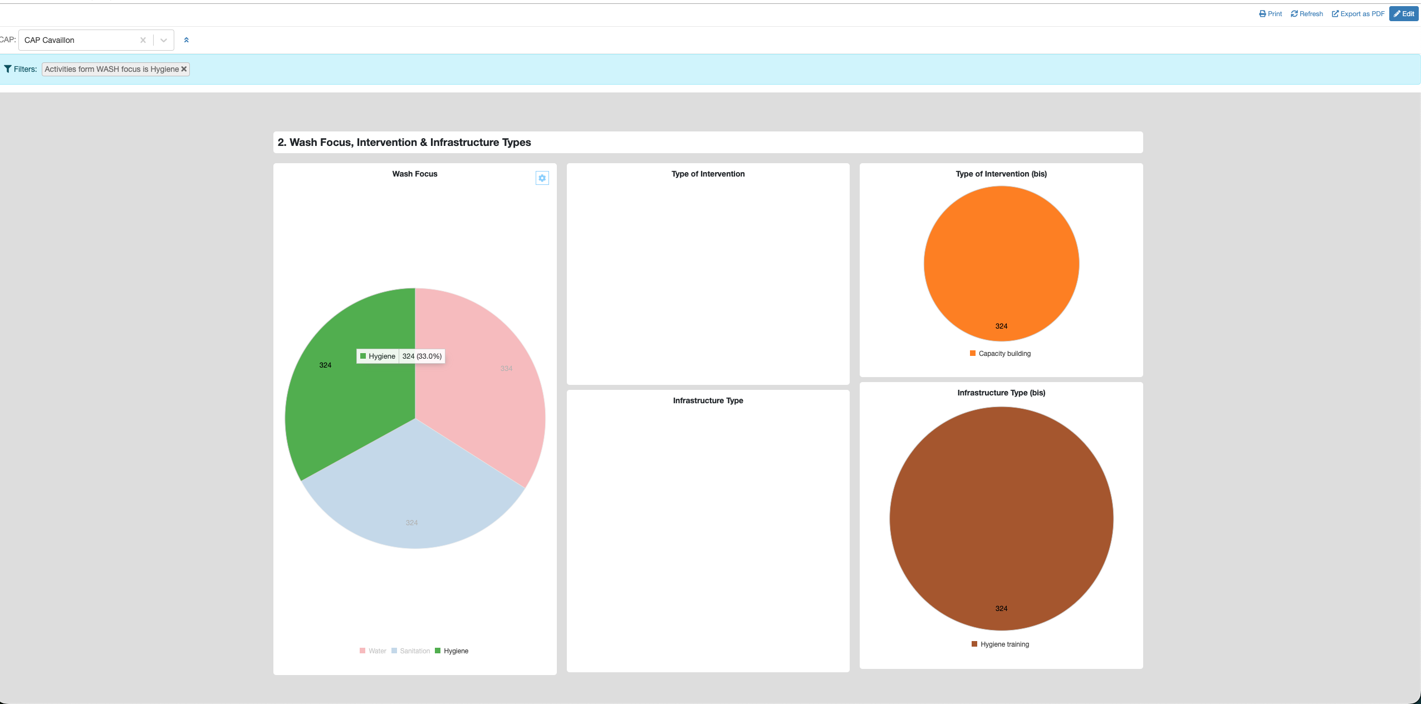
Pie Charts
Click on the x button to close this filter view
A new filter view is now open
Click on a wash focus
The cluster react to the selection

Slide 22
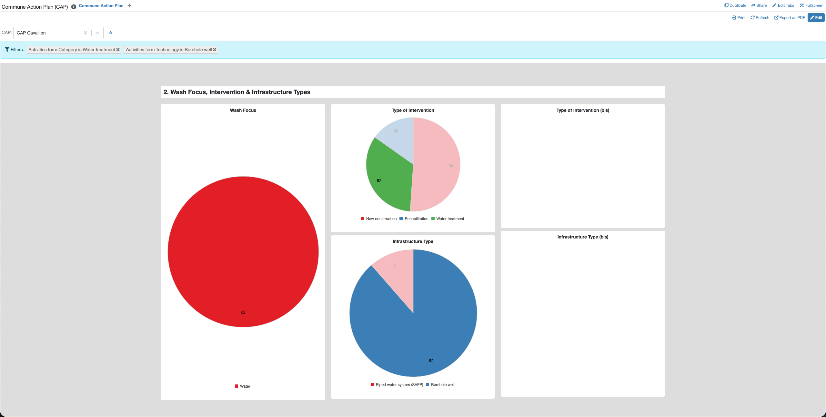
Pie Charts
When it make sense, you can select segment from different related pie charts
The filter view support multiple selection. If the logic make sense.

Slide 23
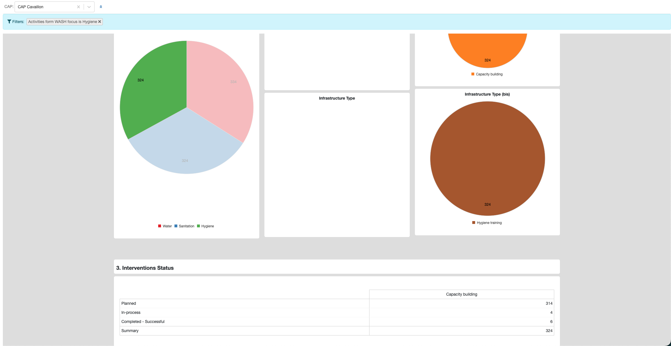
Pivot table & Pie CHarts
One of the wash focus has been selected
The filter View.
The table will redisign itself to make sense
The pivot table is link logically with the pie chart cluters

Slide 24
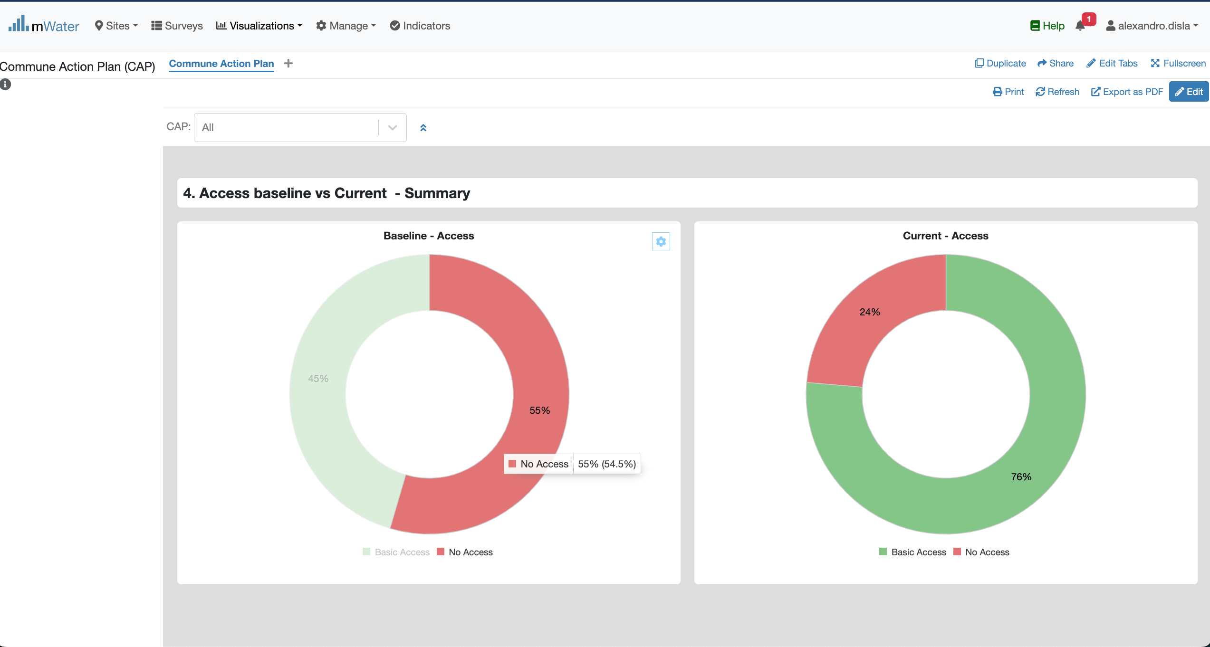
Donut Charts
Hover Effect feature

Slide 25
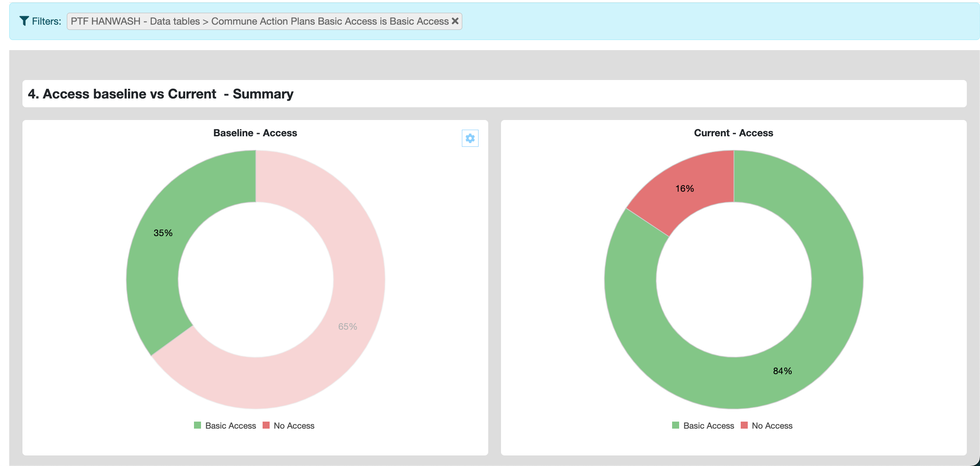
donut Charts

Slide 26
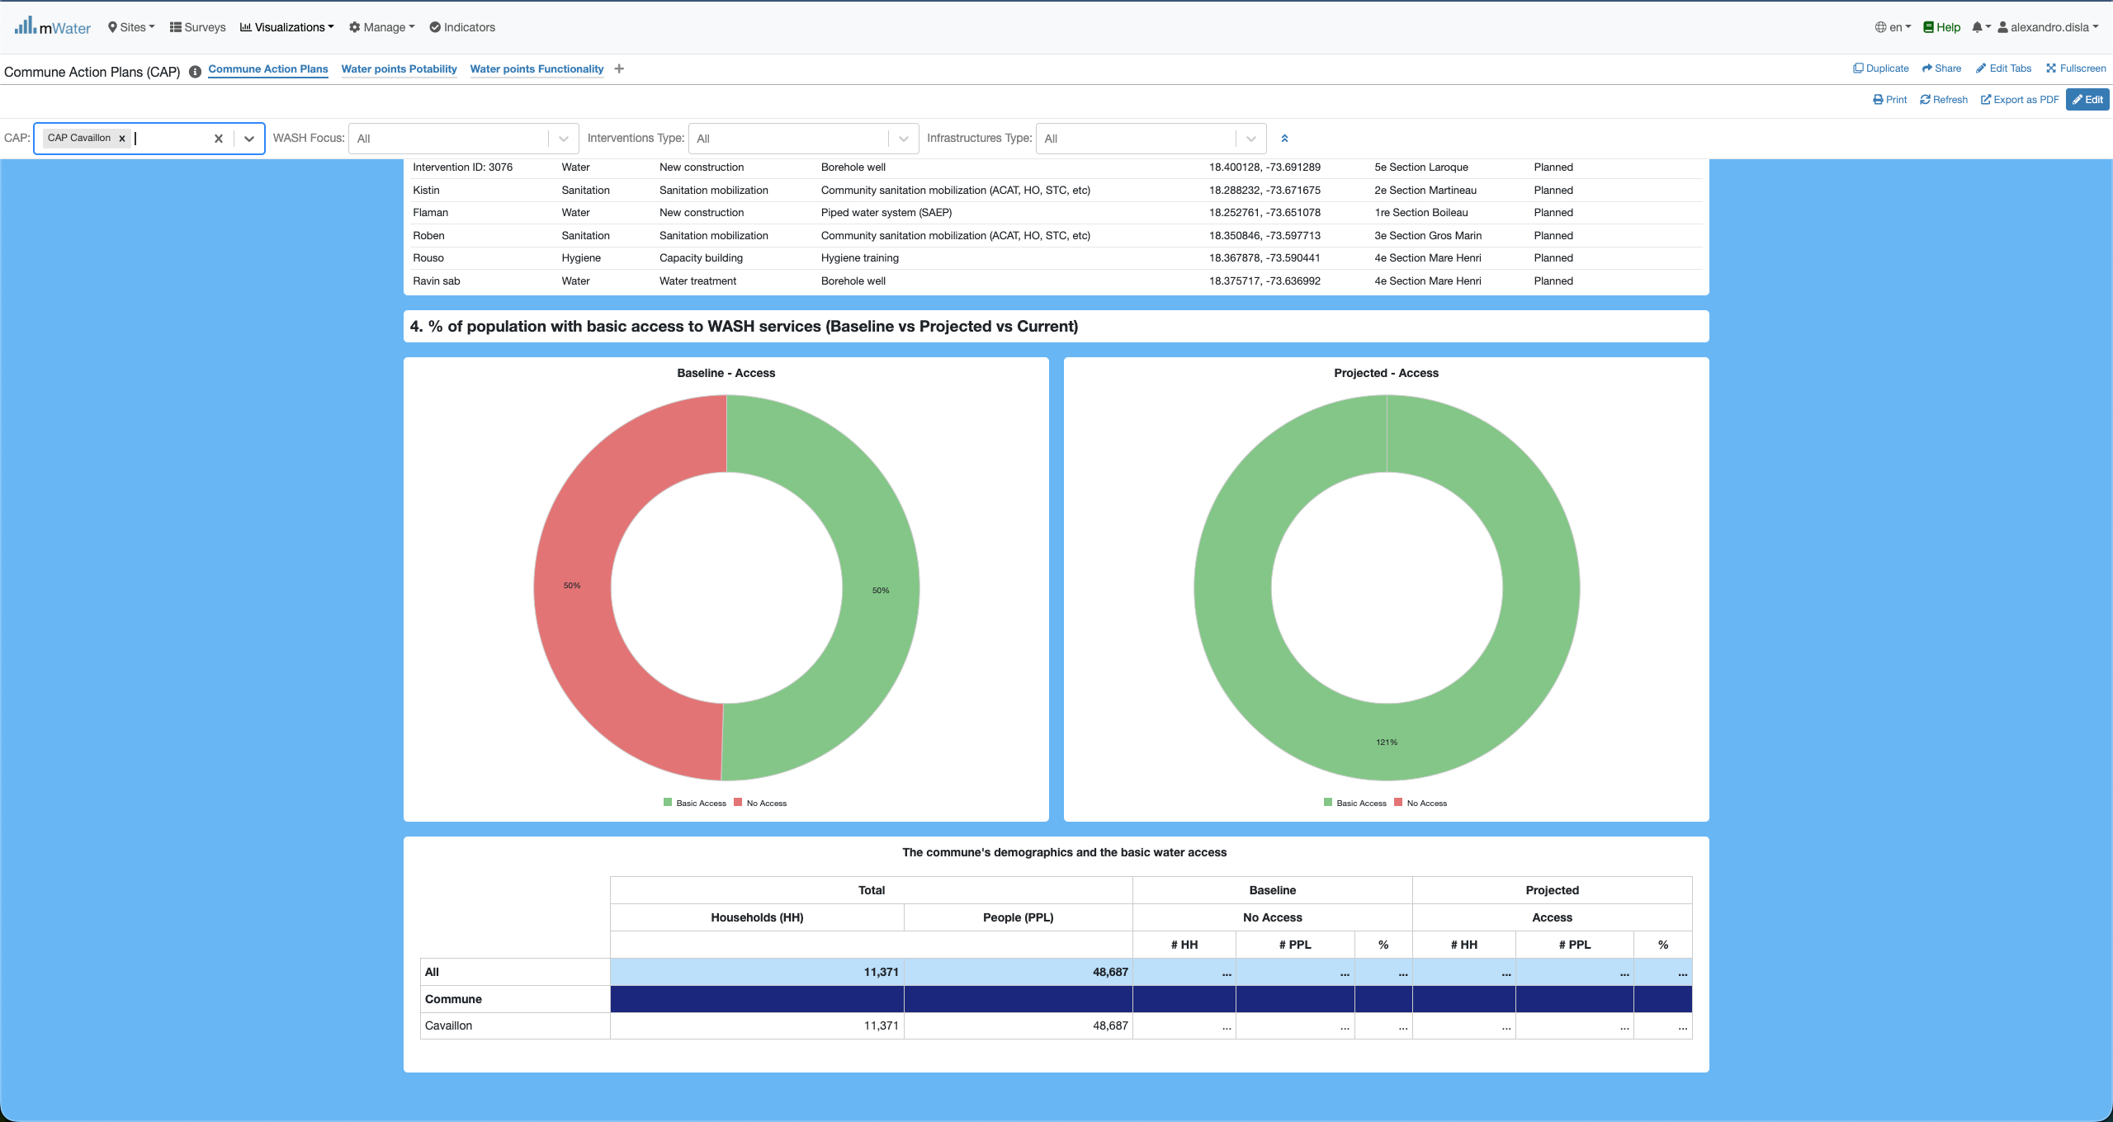
Donut charts & Demographics

Slide 27
Export

Slide 28
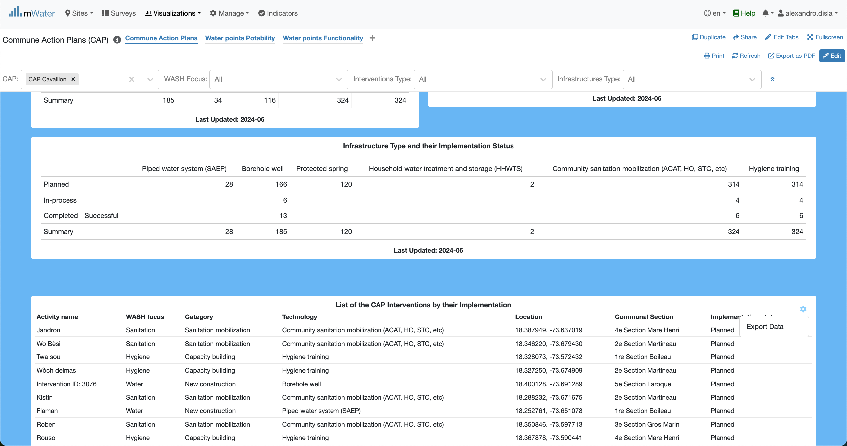
You can export a table
Now you can click the export data button to get into the next final step

Slide 29
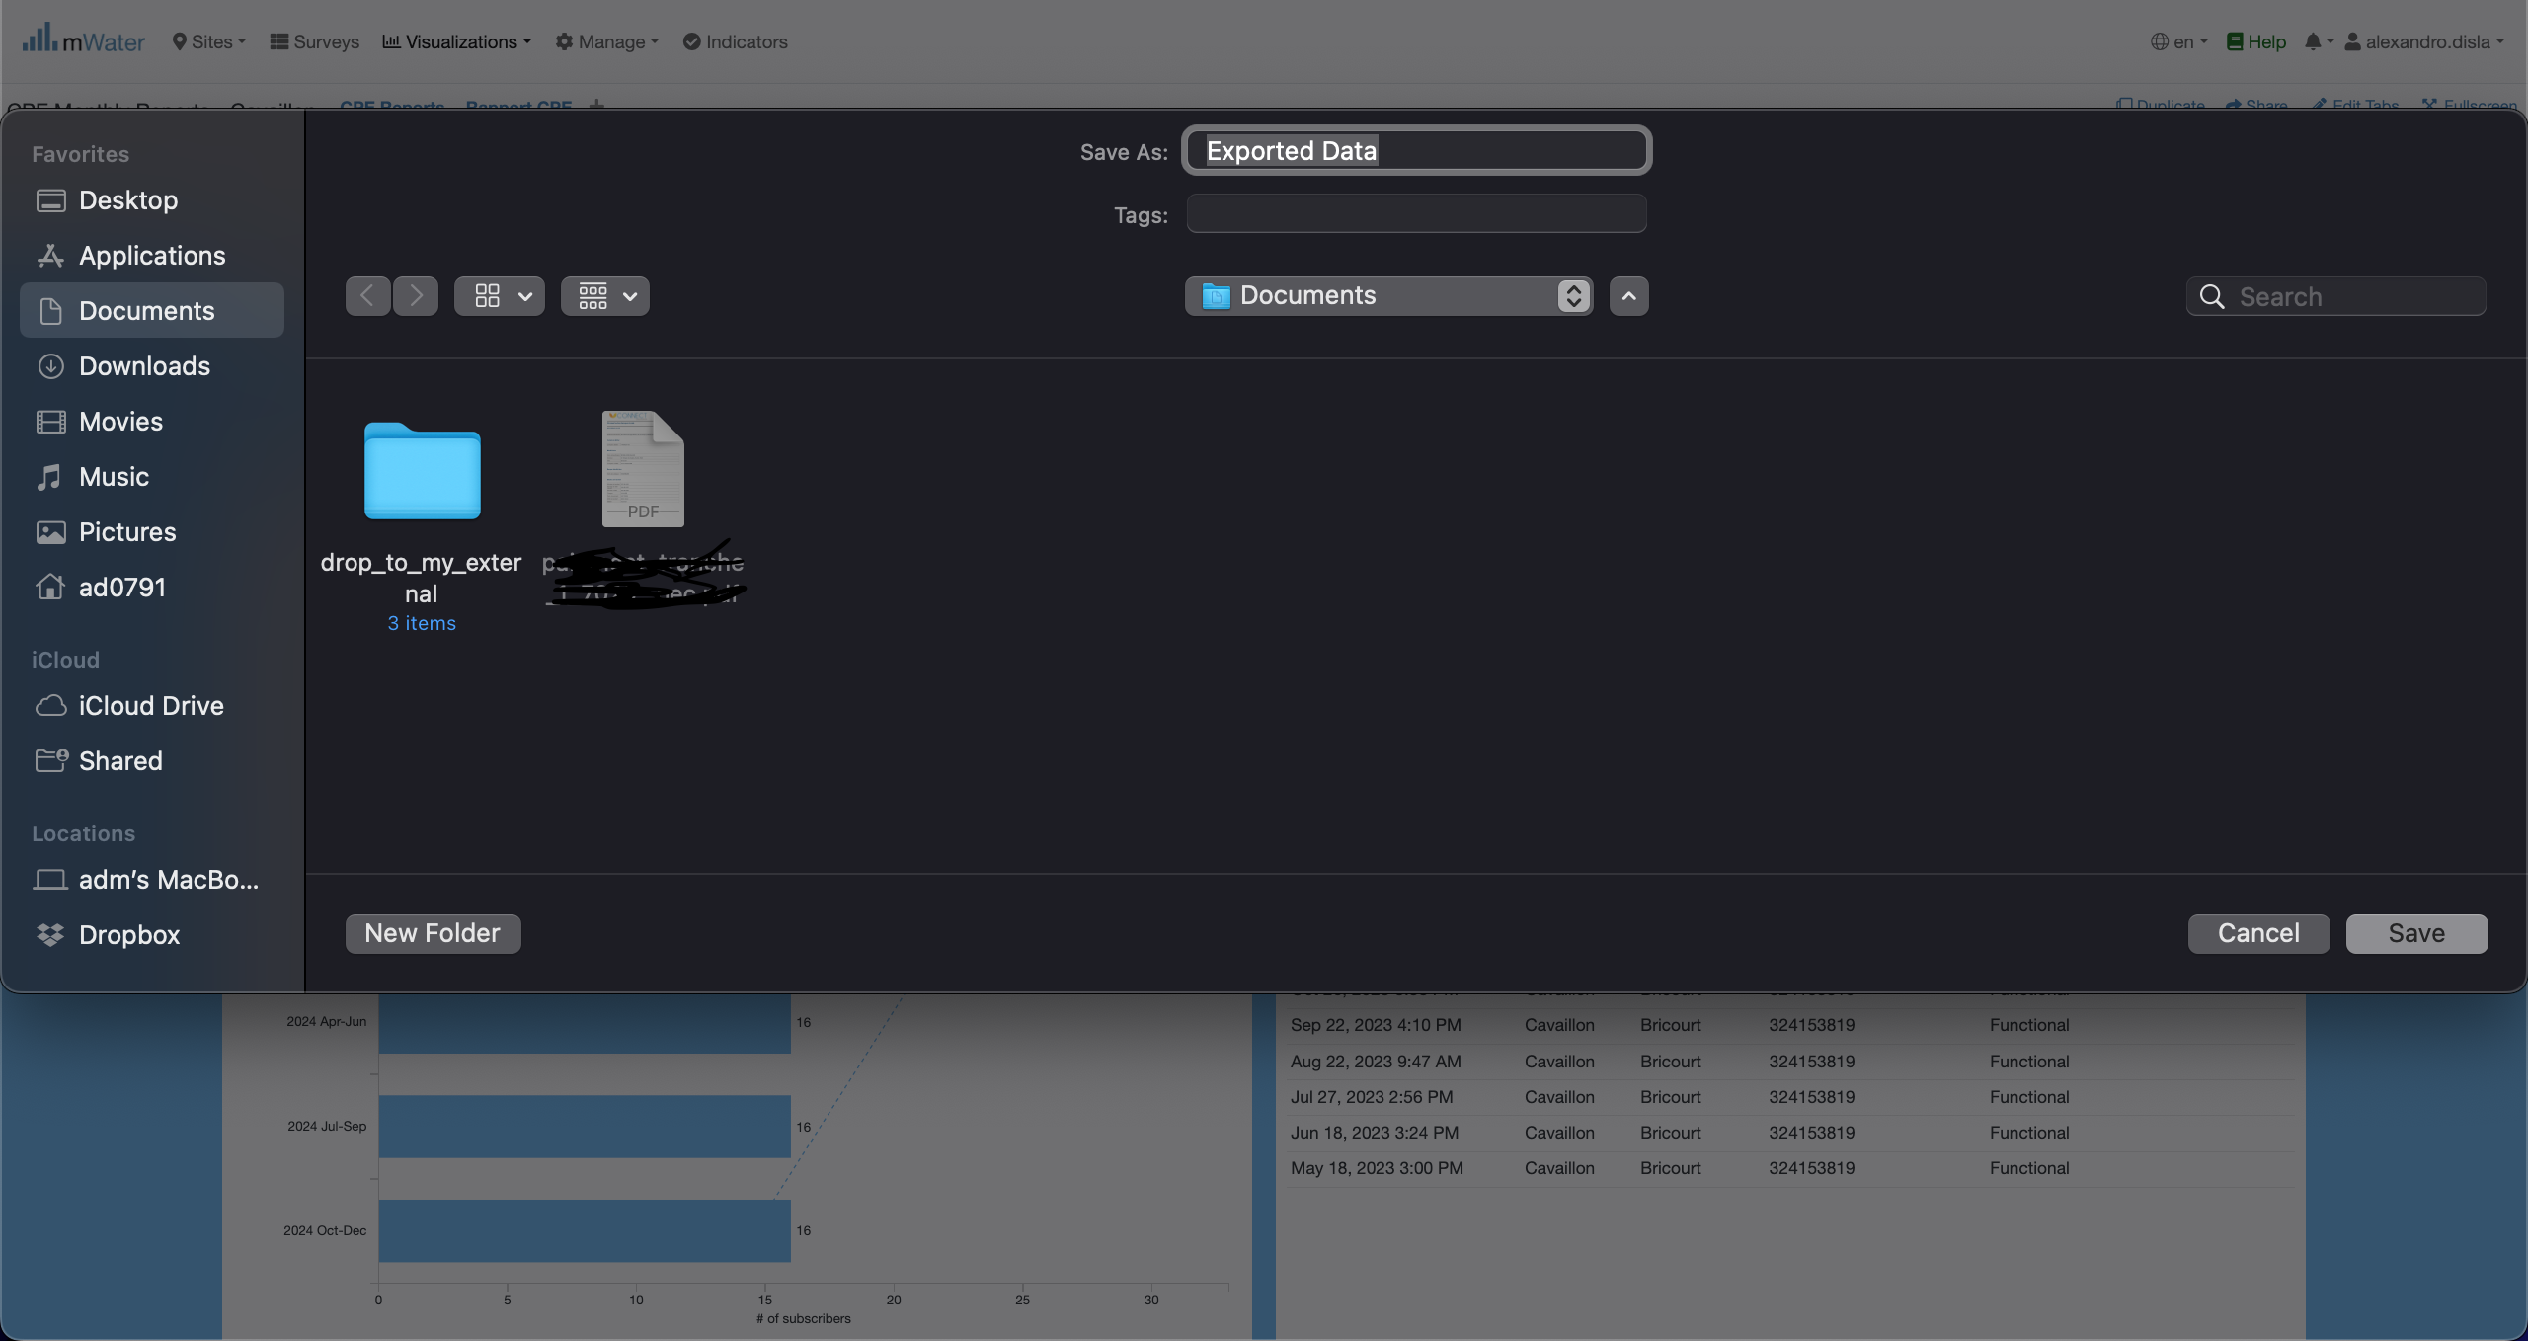
You can export a table
Since I am using a macos. Your interface might be different. You can change the name of the export table as you see fit. After that you can choose to cancel or save the document. By default, in macos it will save the document (spreadsheet) into the Documents folder.

Slide 30
Other export options
The print and the export as pdf are the two standard way to export the results of the console into pdf. However, the export as pdf is recommanded because of his efficiency.
Don’t forget that the quick filters must be active. In order for the console to display the results.

Slide 31
Thank You !!!
PLEASE FEEL FREE TO CONTACT ME BY :
Email / alexandro.disla@hanwash.org
Whatsap or Phone / +50941483700

